Slide 1
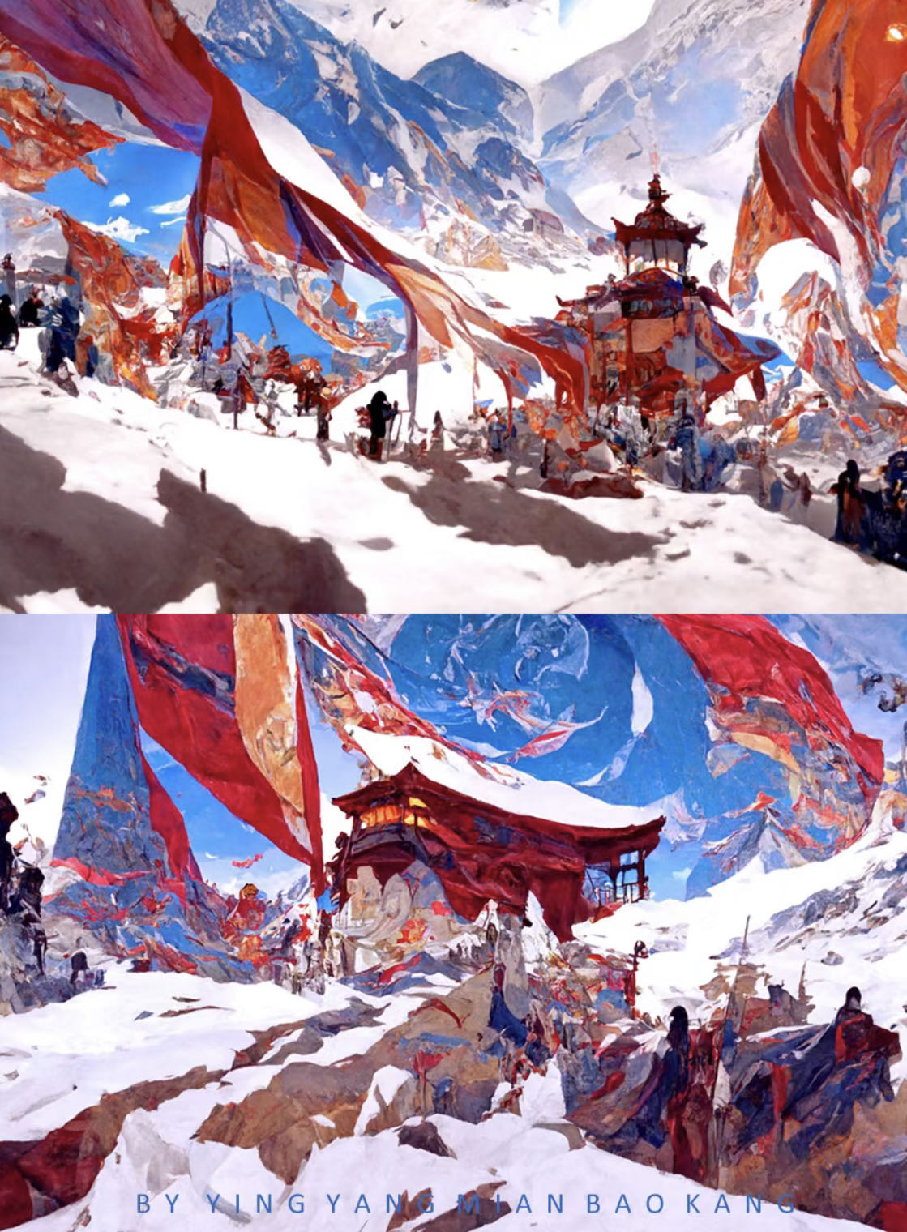
Tianqi Xu
MA VISUAL EFFECT
Tibet

Slide 2
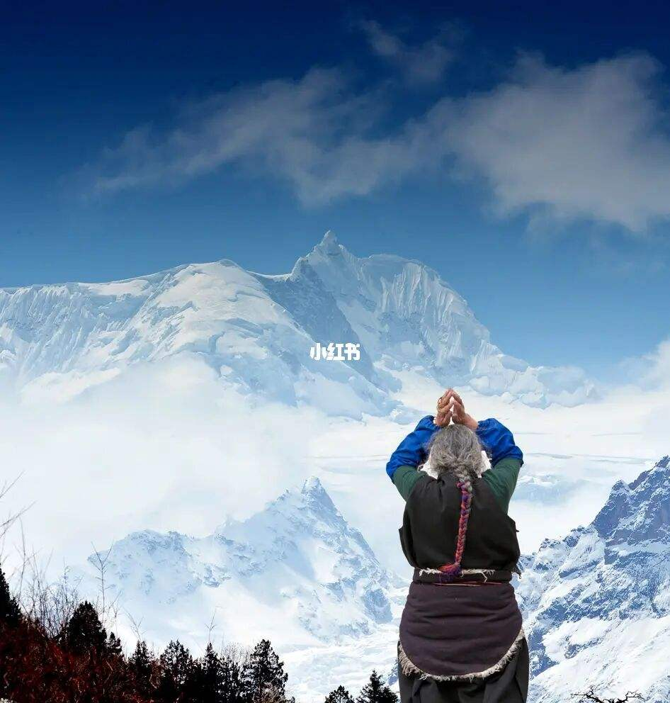
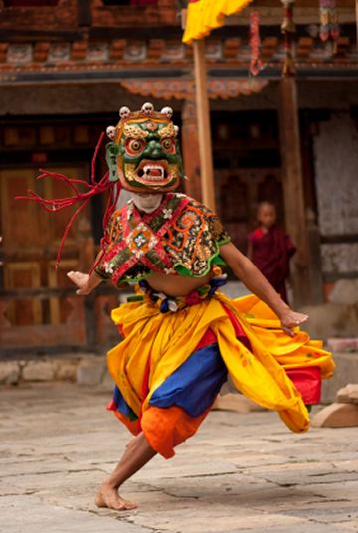
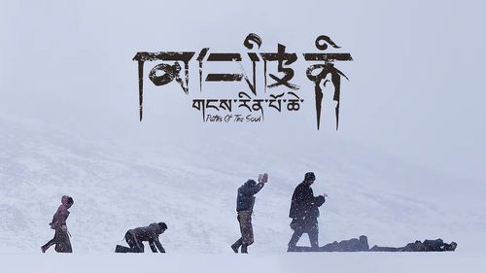
What I want to do is a CG short film with Tibetan regional characteristics. Tibet has been made the least faithful place in the world, where people believe in Tibetan Buddhism and are very loyal.

Slide 3
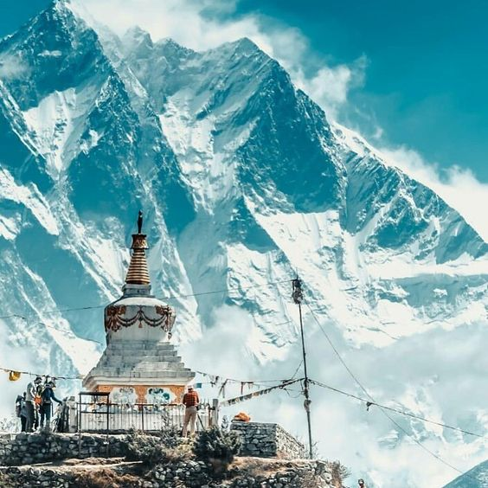
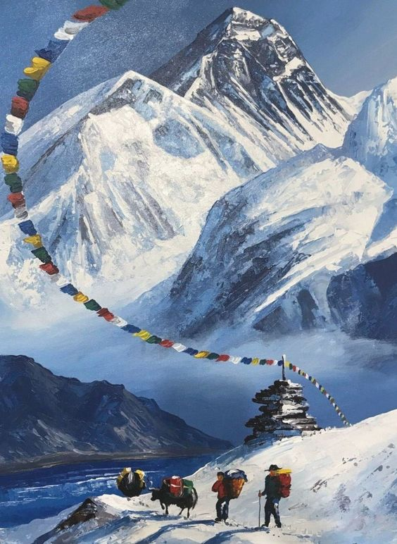
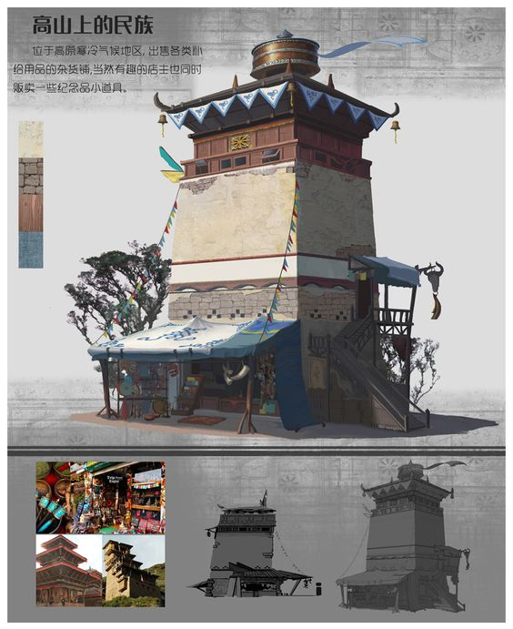
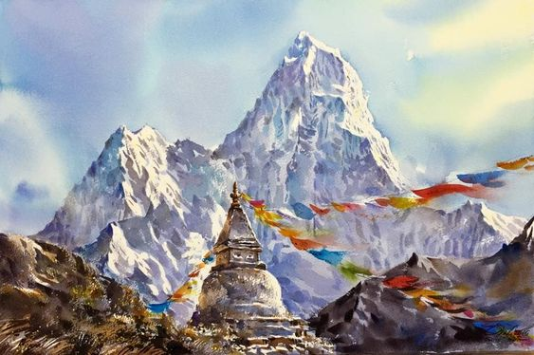
For scene reference, I want to do fluttering flags, a model of a tower, and the background with mattepainting

Slide 4
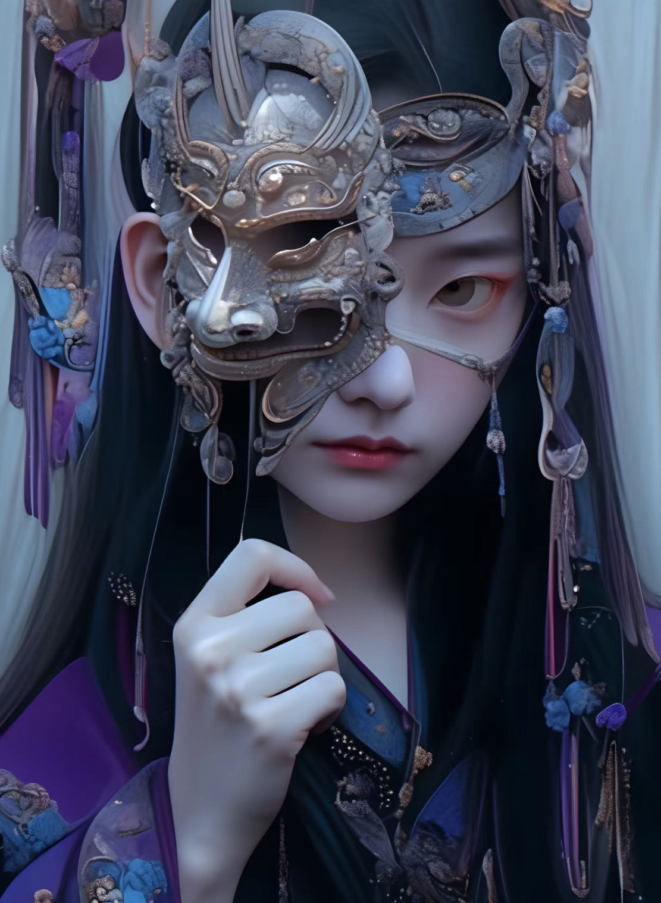
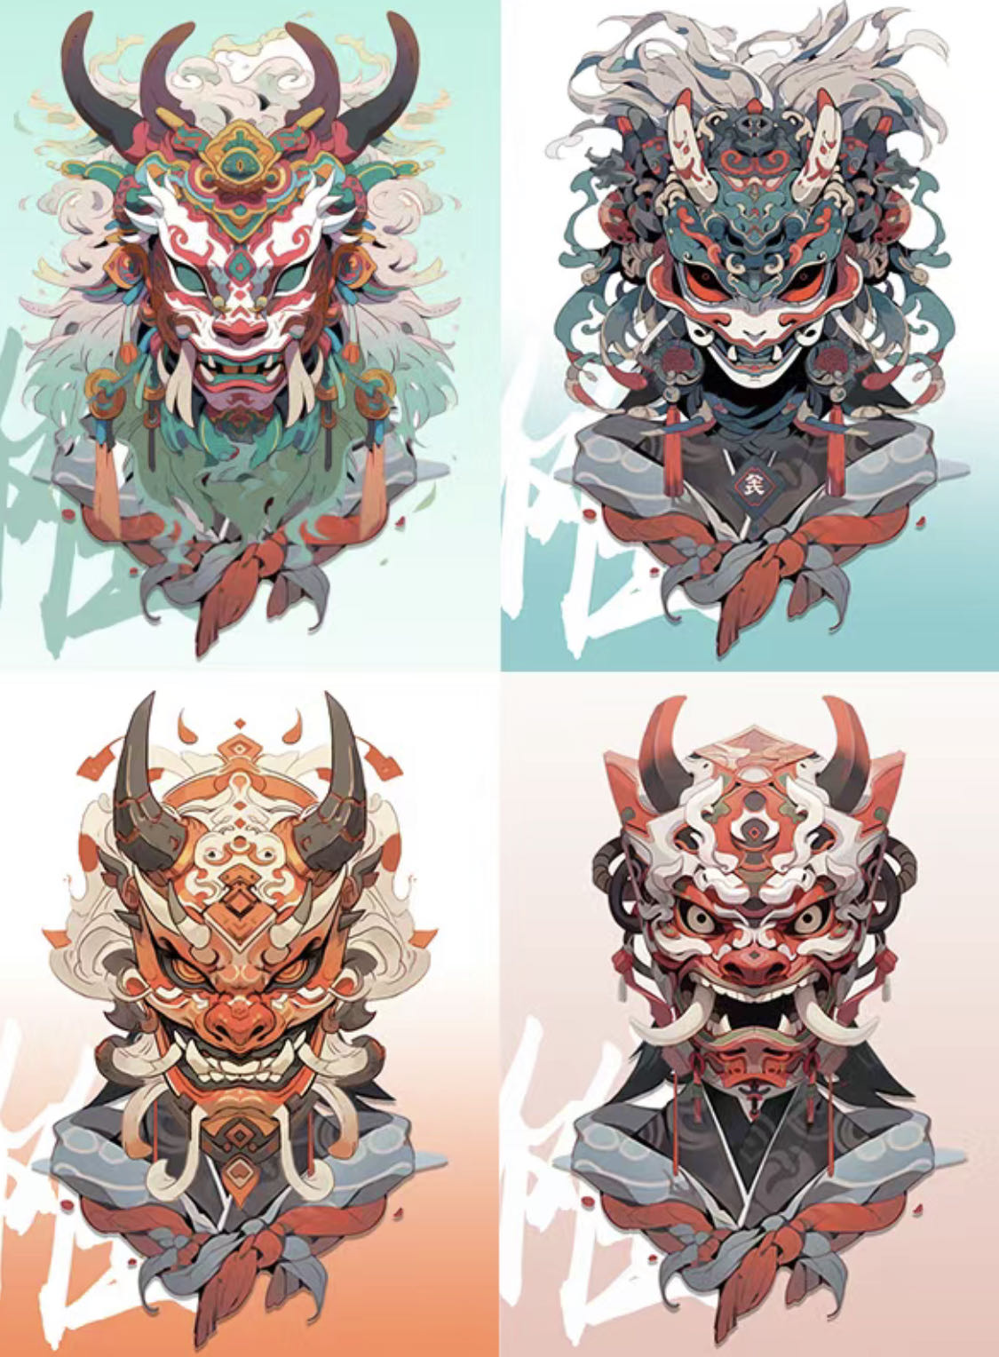
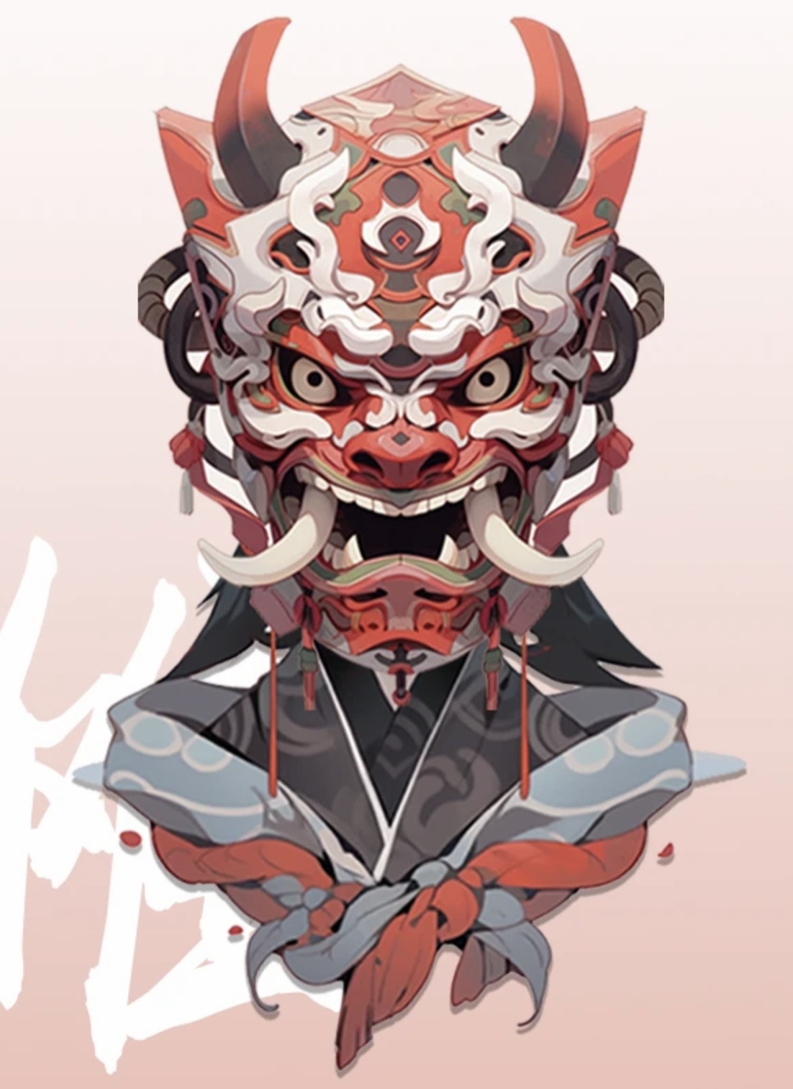
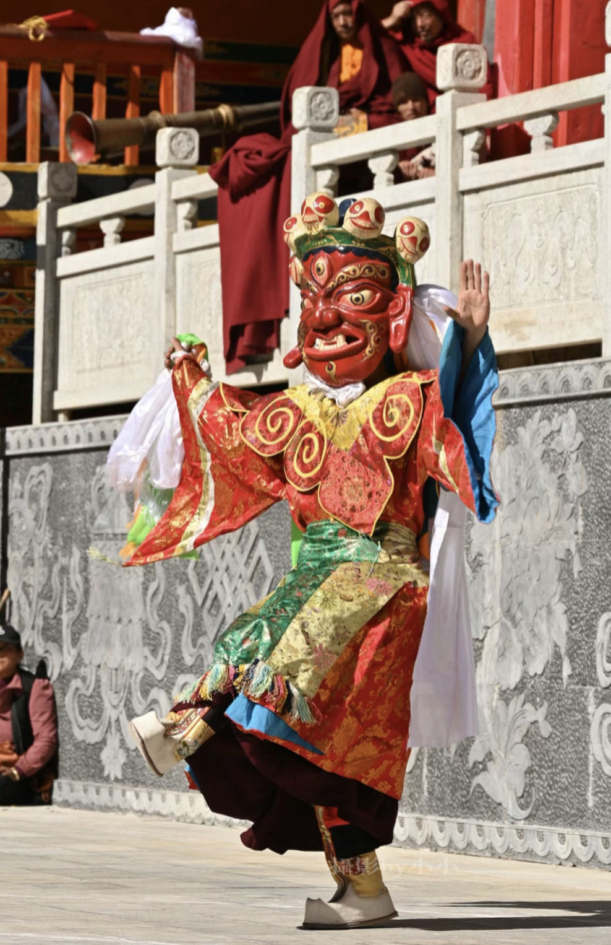
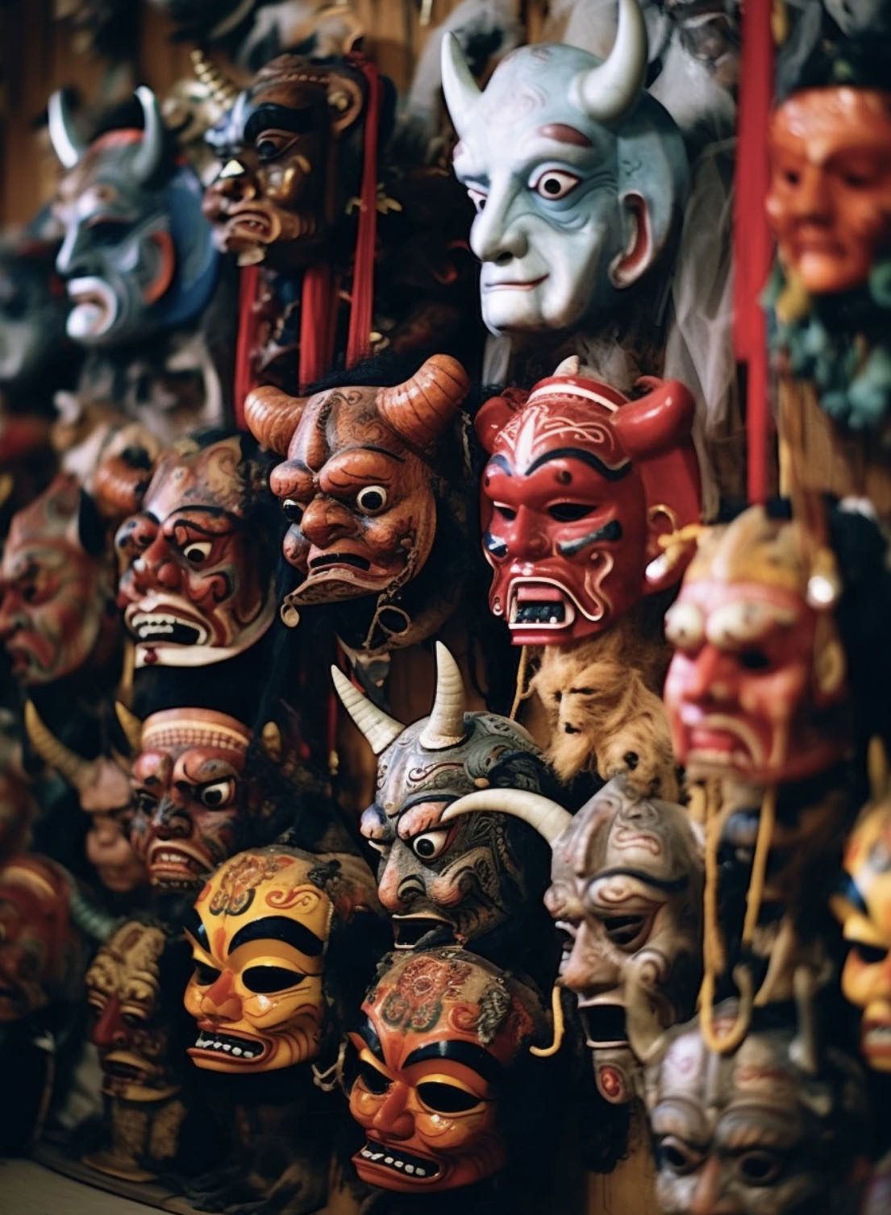
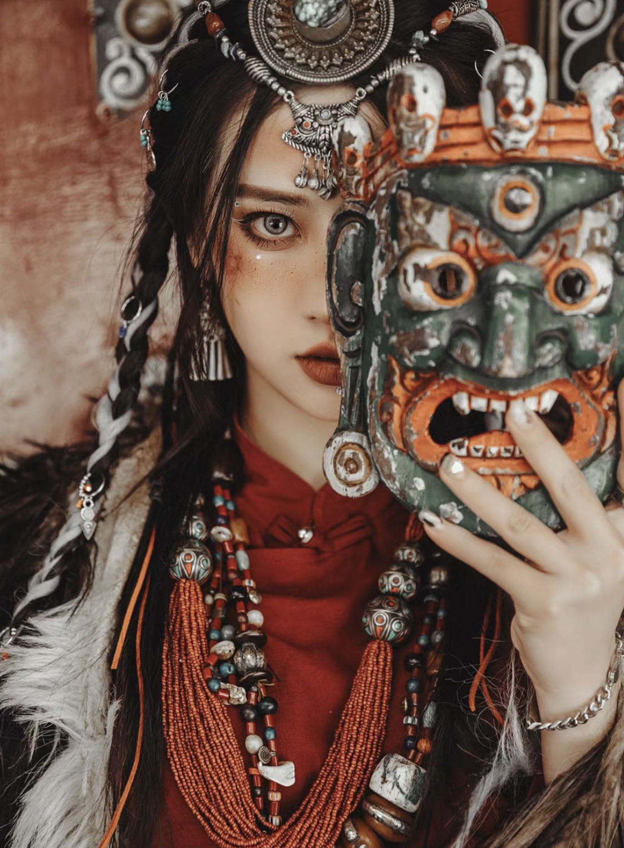
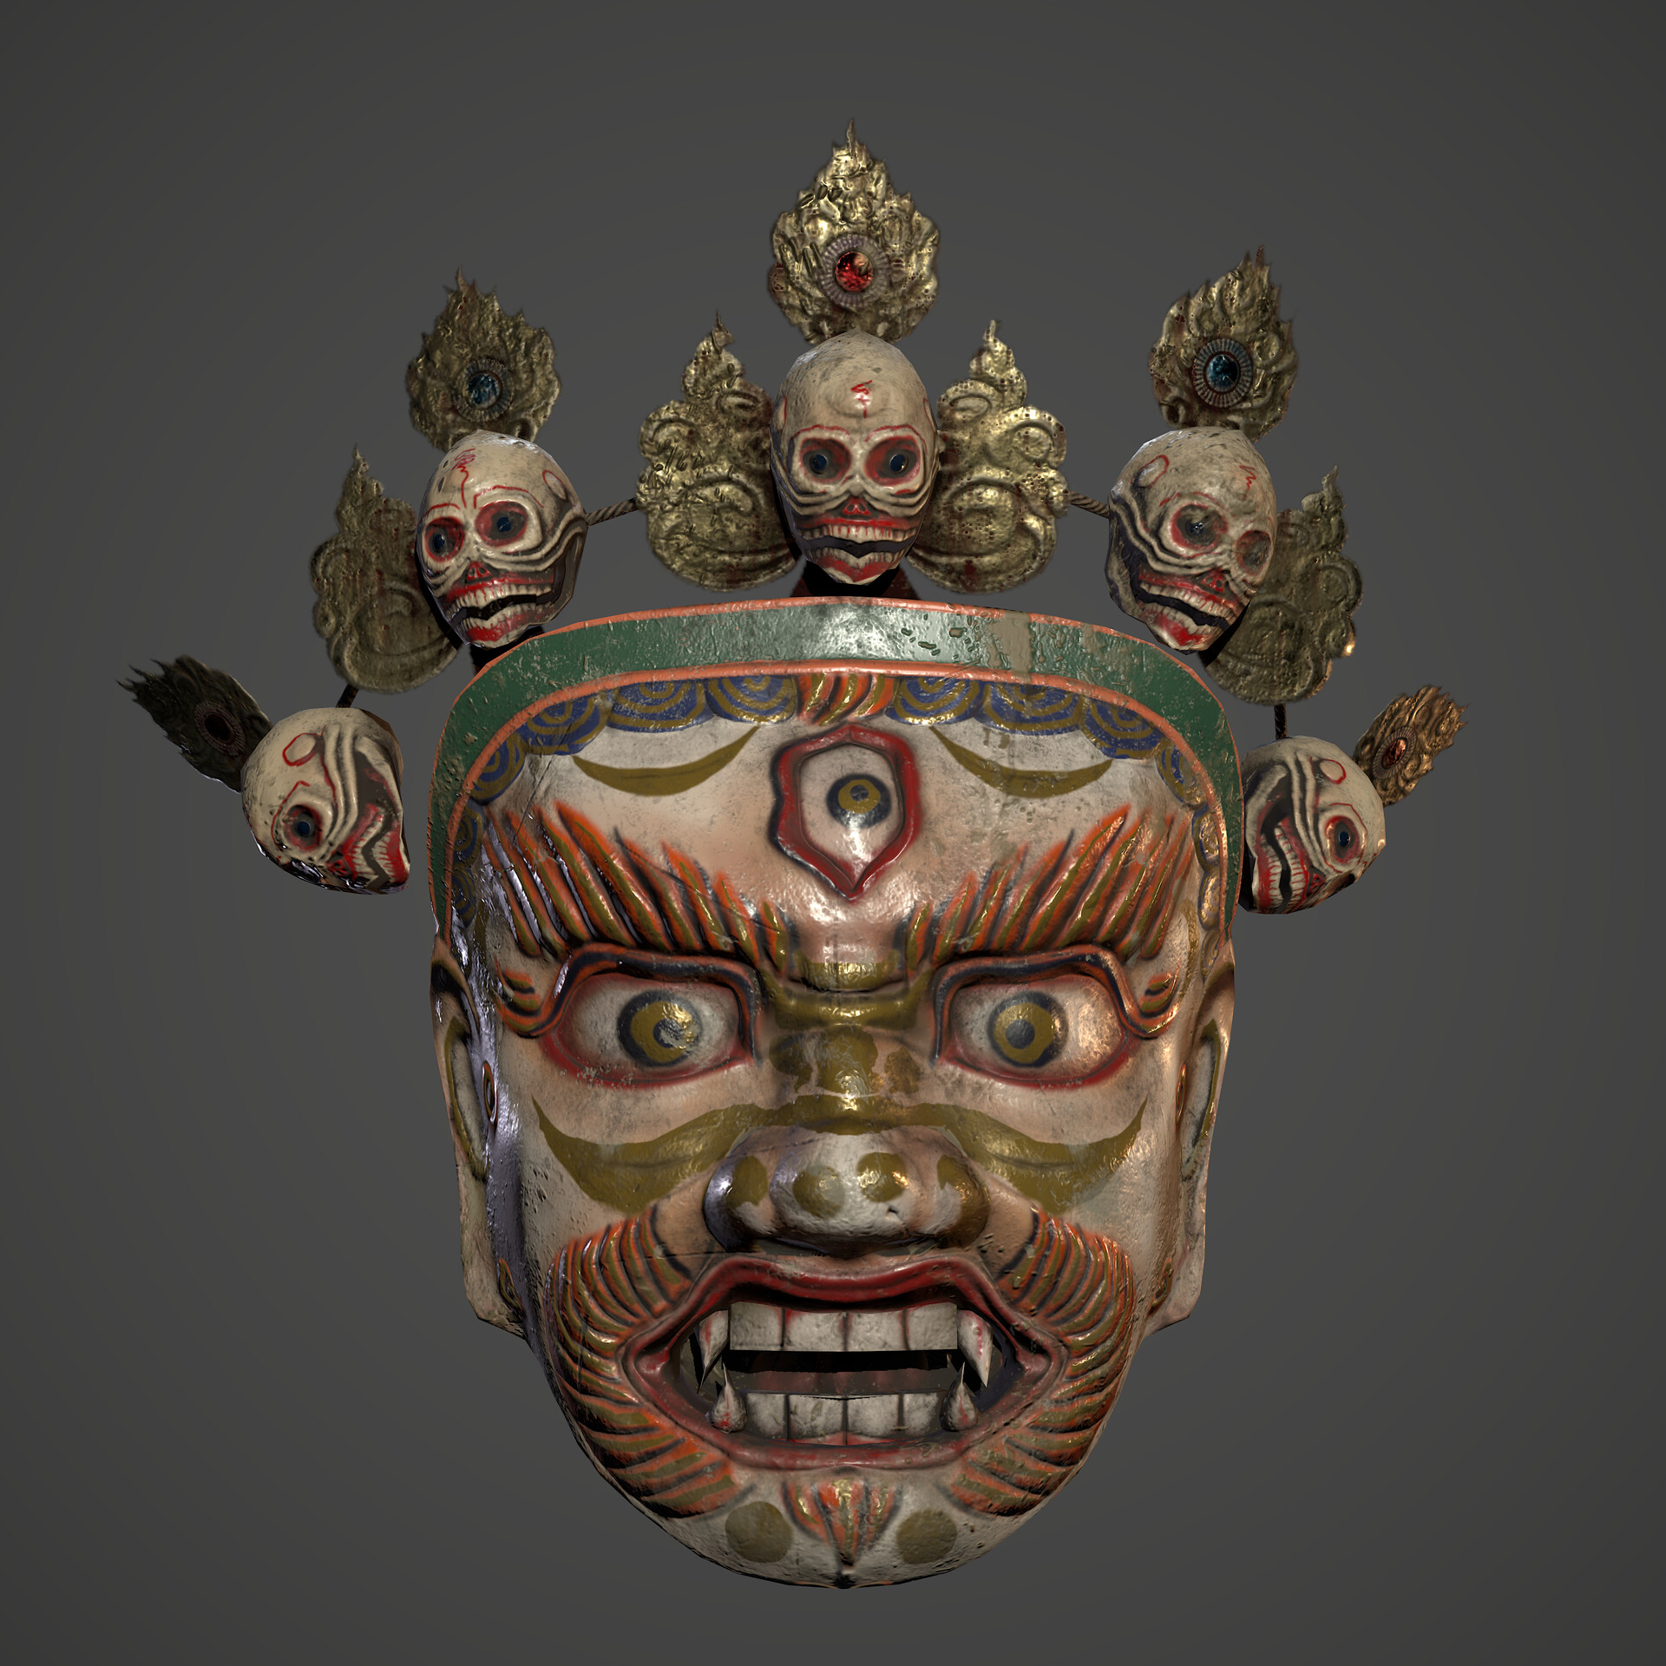
Masks and cultural references

Slide 5
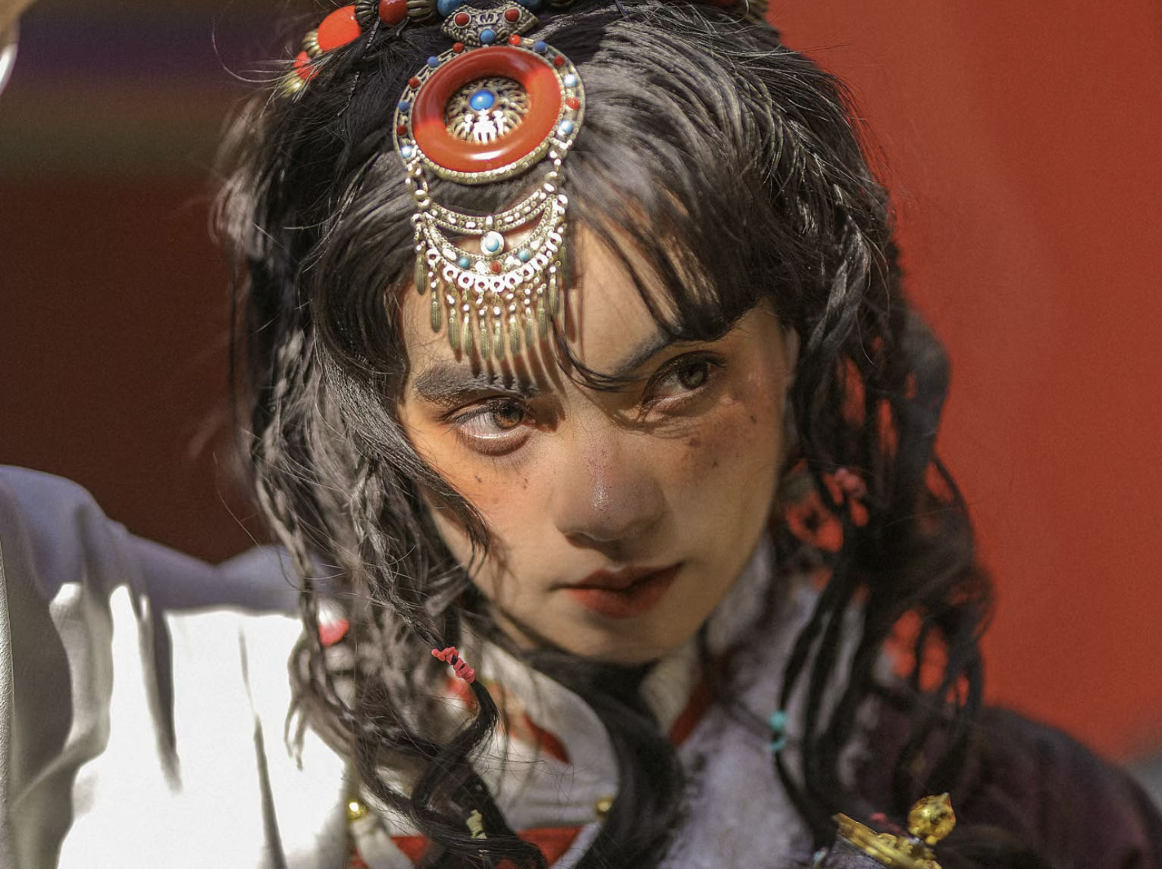
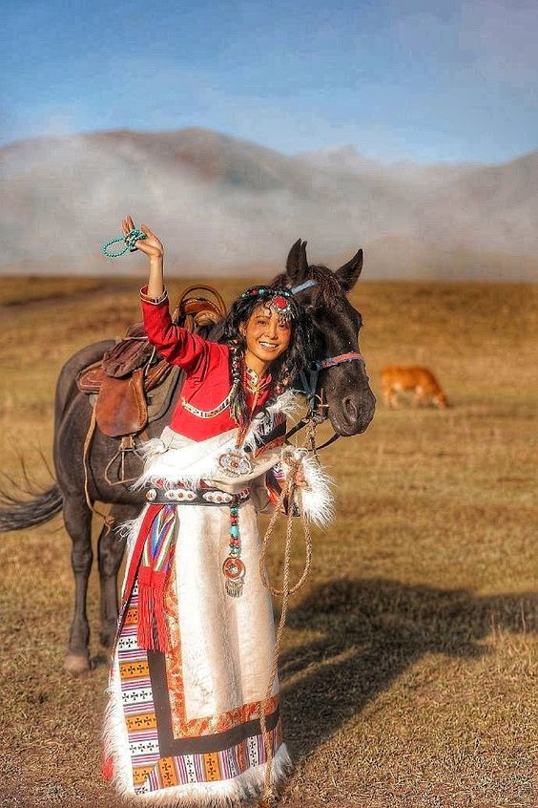
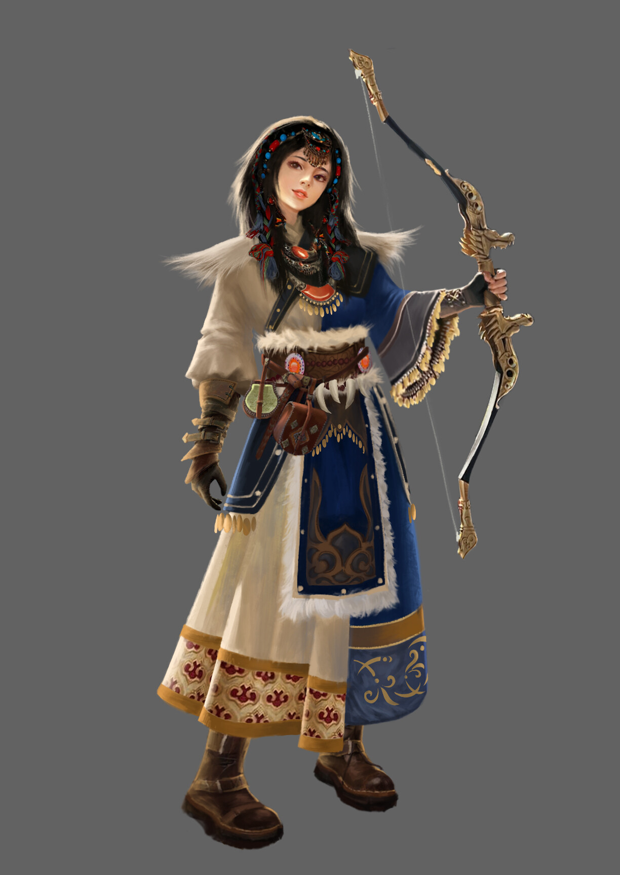
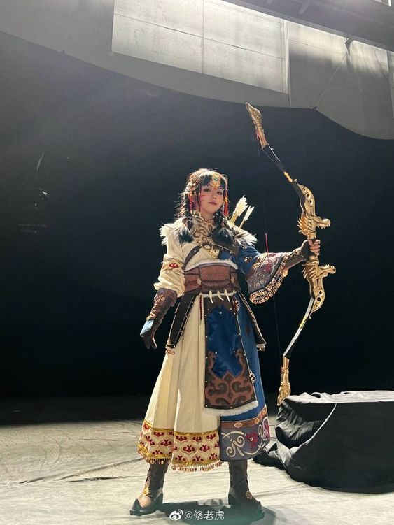
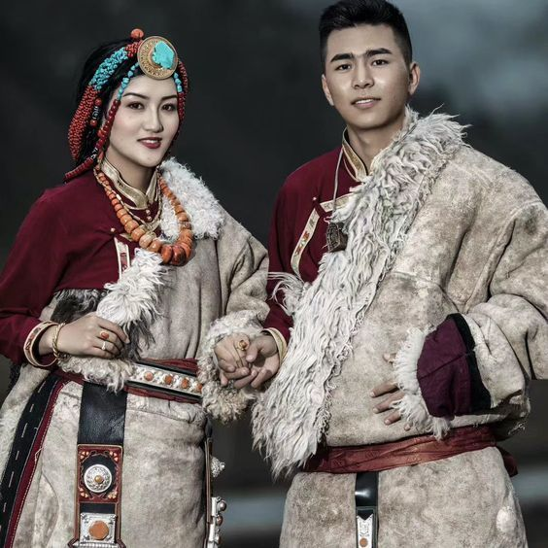
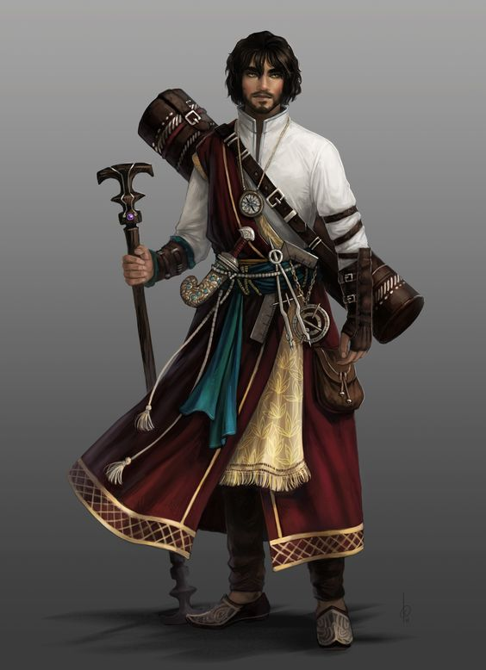
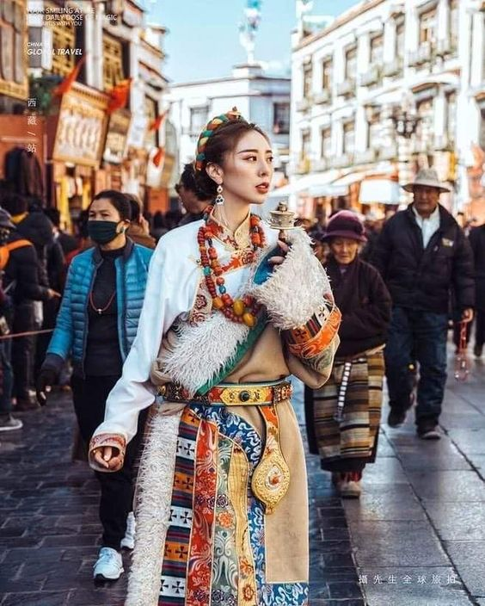
Character
references

Slide 6
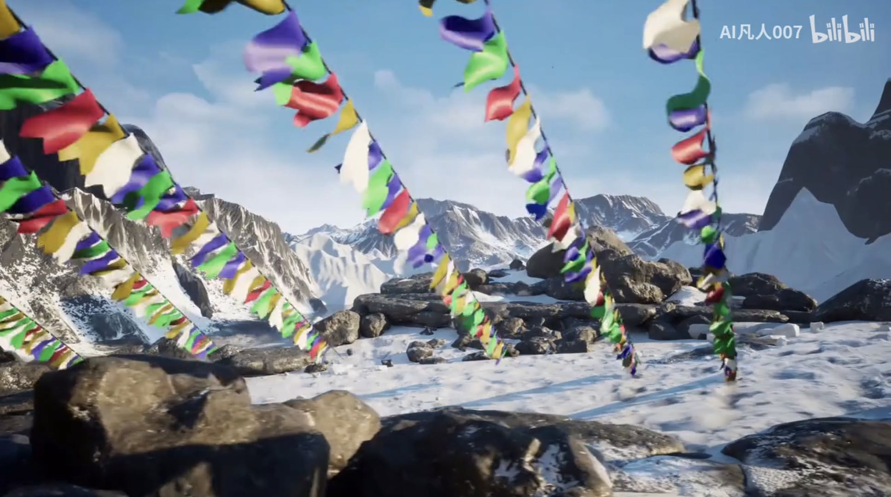
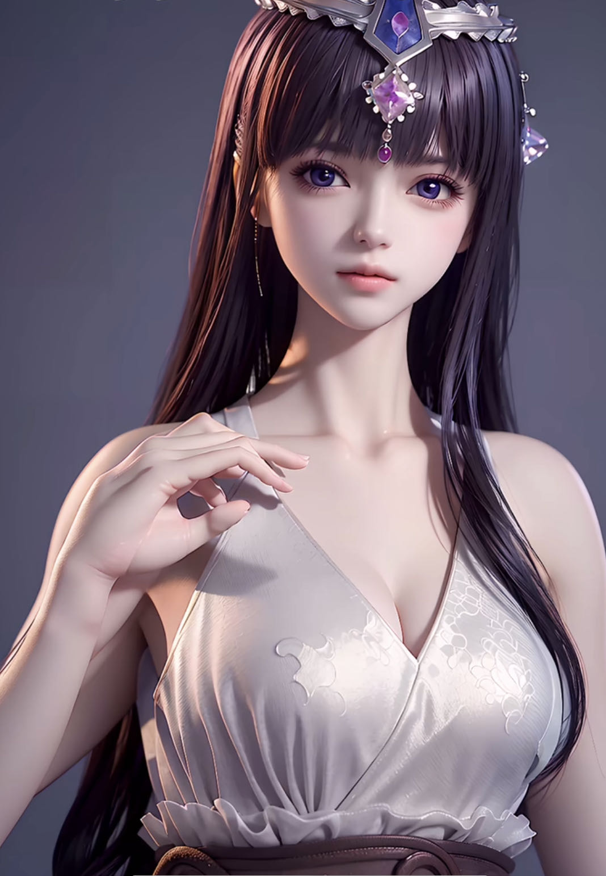
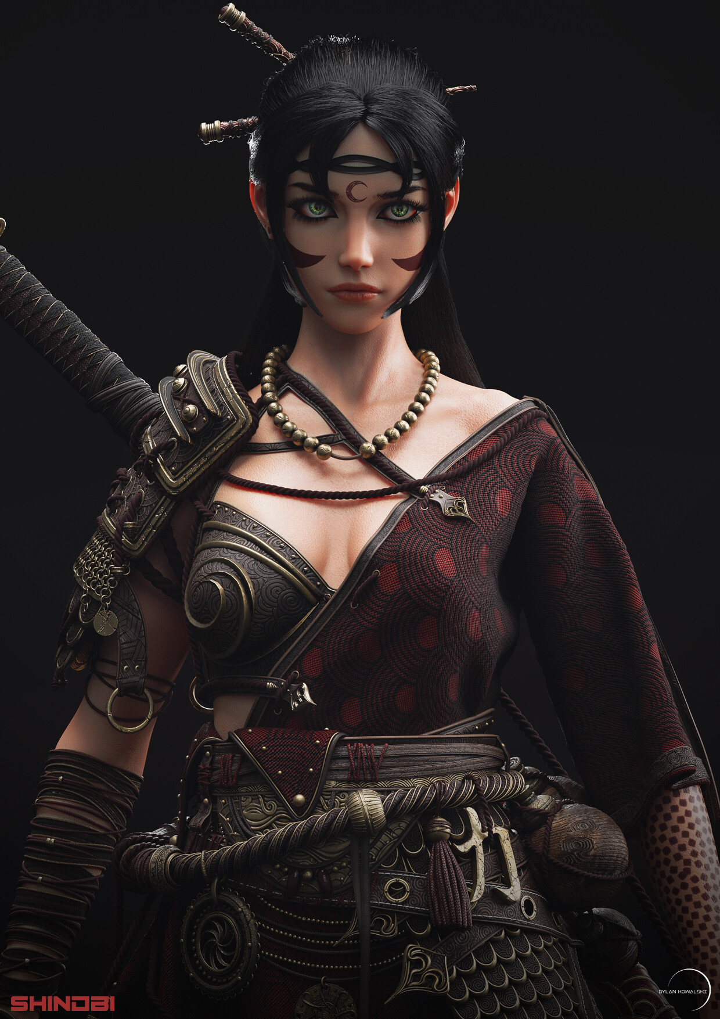
Model and CG style reference

Slide 7
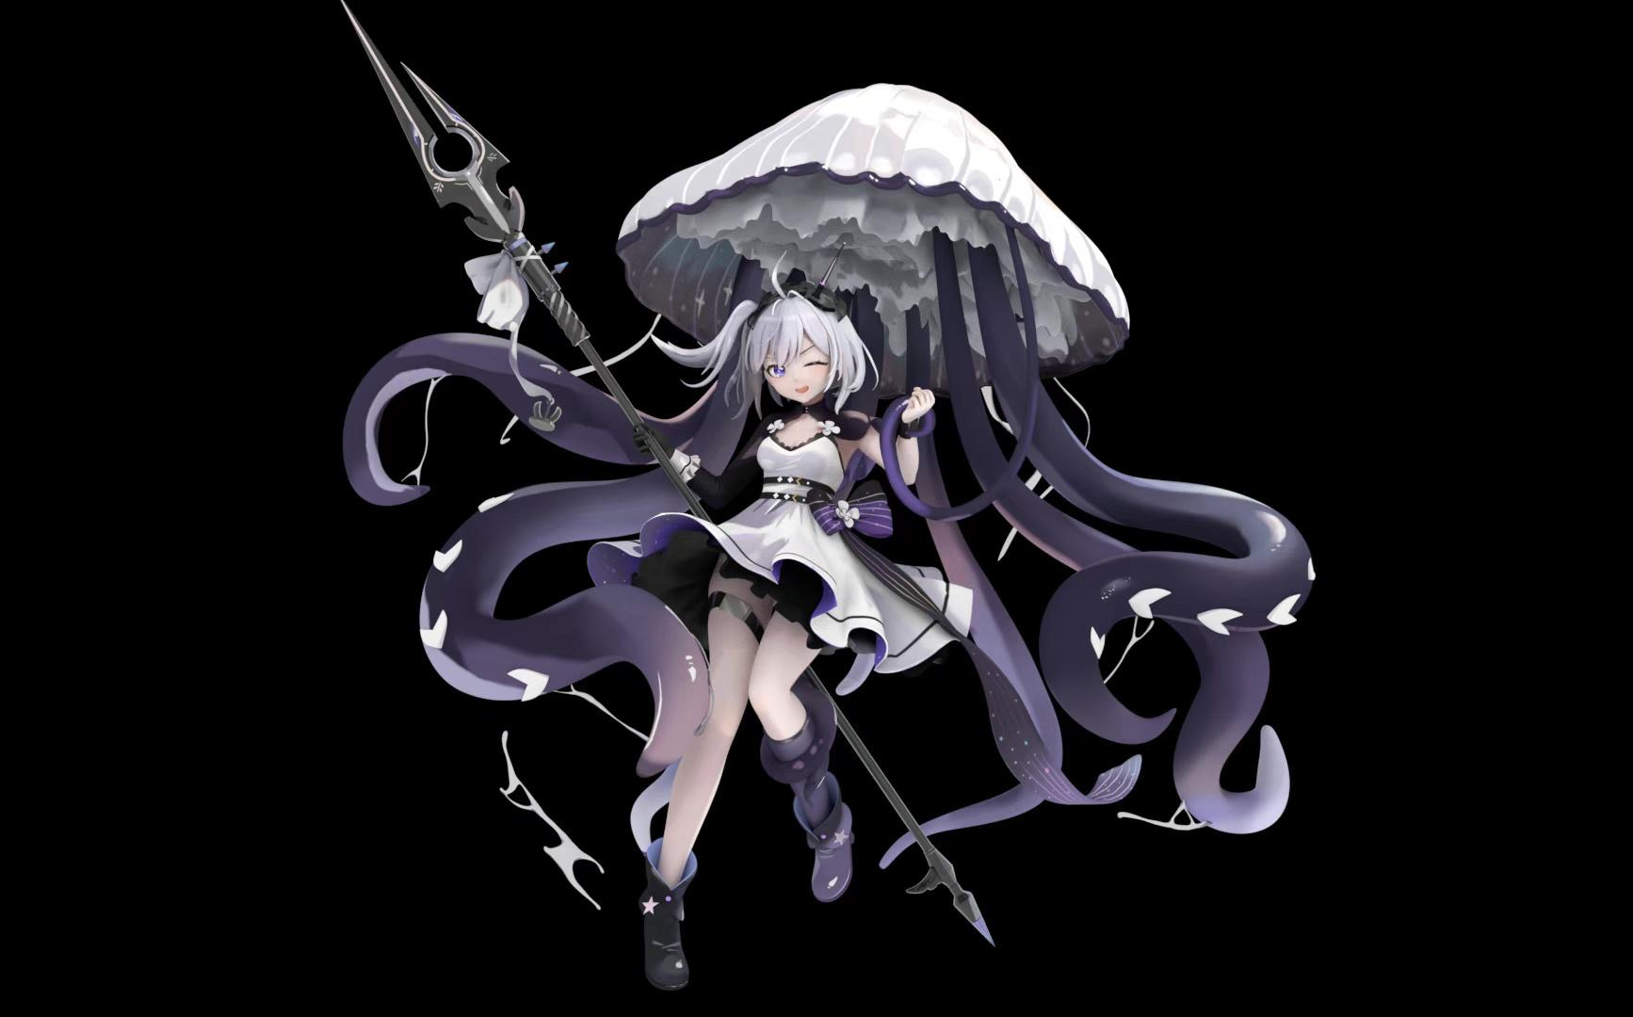
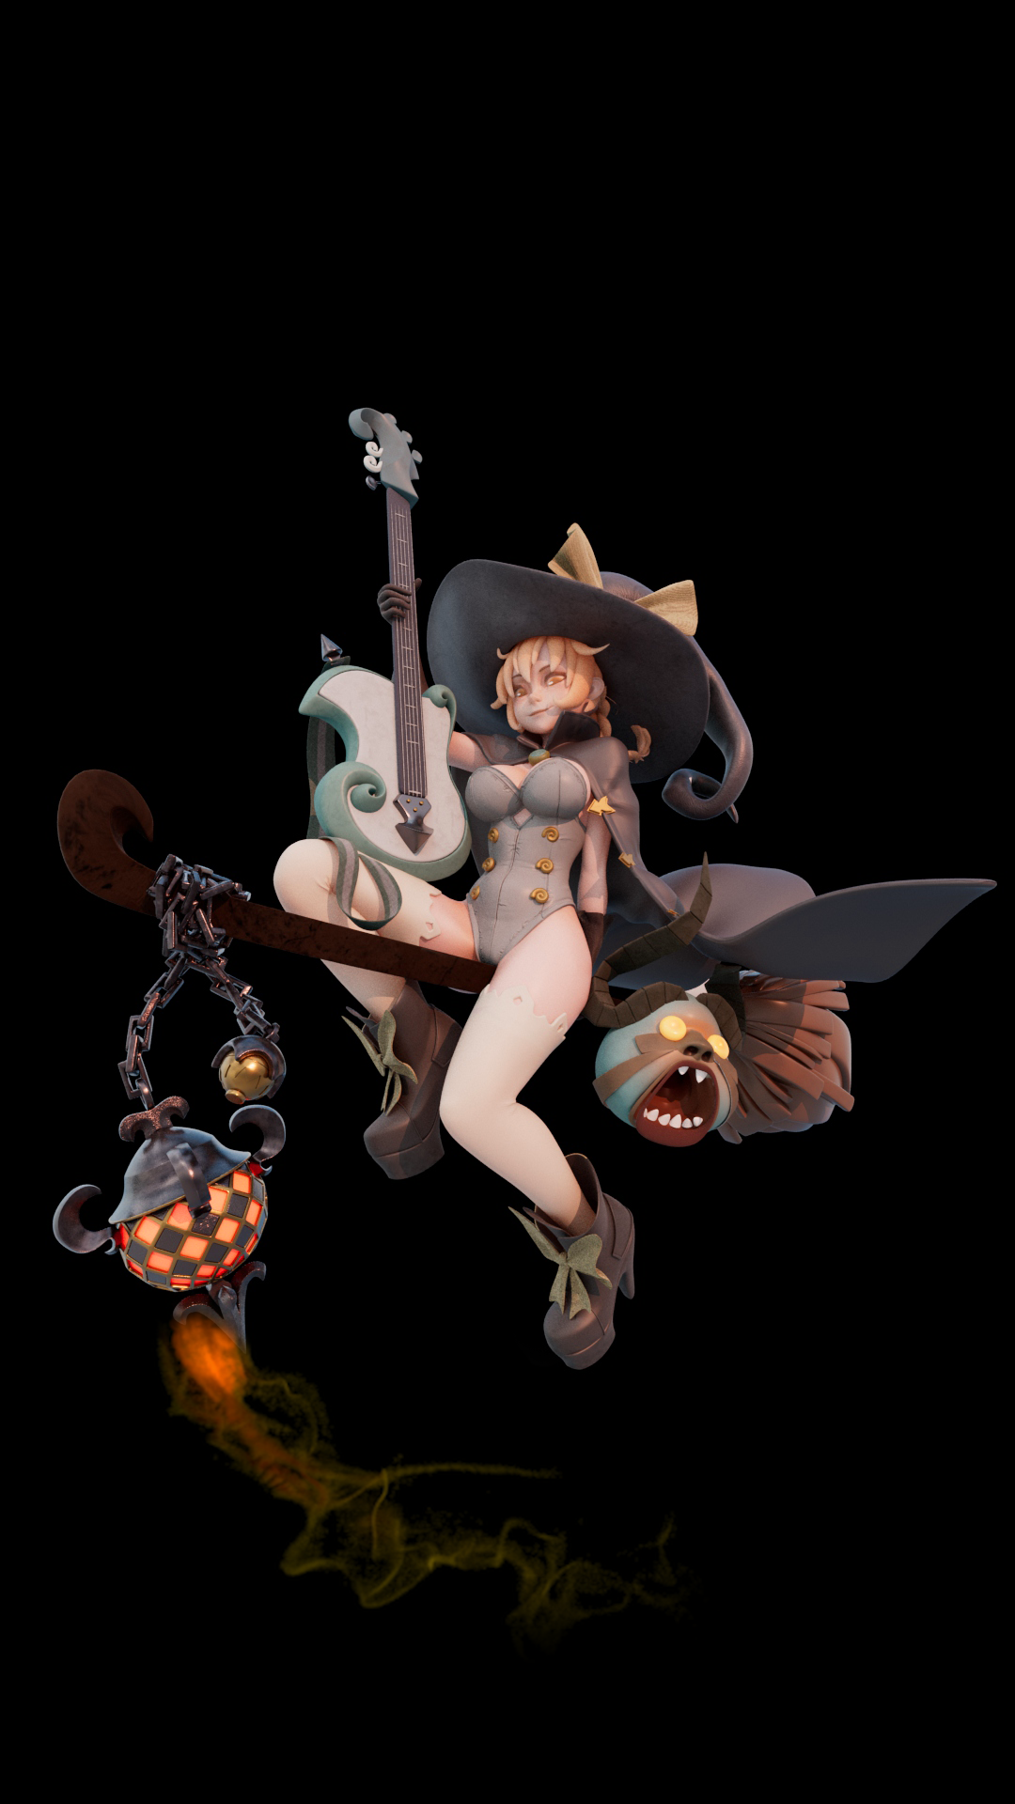
1. storyboard preconceptions: flag close-up, scene display, mask close-up, close-up mask removal animation, panorama.
Contains a character, a mask, a tower, flags floating in the wind, snowy mountains in the distance.
2. how to achieve: the character after carving the character with zb to maya binding, key animation, hair by xgen , animation into the MD after the clothes hit version of the solution.
Scene flag fluttering with maya or md or houdini wind field blowing, tower is a model, use mattepainting to make snowy mountains .
3. skills point: I can do the role, but xgen with general, not used xgen did twist, has found the tutorial.
I can md typing version, but did not combine the role of animation to do the solution, has found the tutorial.
I am not good at animation, so avoid a large animation, the character has a mask off the action. Binding with plug-ins.
About the flag specific with which wind field to achieve the fluttering animation, there is still to think.
The models I completed in the last two terms. For this project I wanted to have a simple animation for the new character.

