Slide 1
Feminism in Pixar Animation:
the growth and awakening of female characters

Slide 2
Chapter1
01
02
Introduction and Literature review
Chapter2
Chapter3
03
04
The origin, development and influence of the feminist movement on cinema
The transformation of female characters in Pixar's animated films
The problems of feminism in film making

Slide 3
01
Introduction and Literature review

Slide 4
Introduction
Literature review
The development of feminist thinking has brought about the diversification and complexity of female character traits in animation. From being created, admired, and chosen, women became the active, controlling party. However, Feminism still suffers from the male power's suffocating influence. I will elaborate and solve the problem from three aspects.
One part of the literature explains the relationship between the fourth wave of feminism and the growth of female characters in film, while another part defines the "post-princess era", which is somewhat controversial.

Slide 5
Chapter1
02
The origin, development and influence of the feminist movement on cinema

Slide 6
Four Waves of Feminism
The third wave of feminism
Focus on individuality and diversity
19th-early 20th century
the first wave of feminism
Promoting Women's Access to Voting Rights
After 1992
After 2012
1960s
The forth wave of feminism
Using social media to advocate for women's rights
Therefore, the transformation of Pixar's female role is more influenced by the third and fourth wave of feminism
The second wave of feminism
Fighting for equality in law and society

Slide 7
Chapter2
03
The transformation of female characters in Pixar's animated films

Slide 8
 | Film title | Female leads or coleads | Original theatrical release date | Synopsis
1 | Brave | Merida | June 22, 2012 | Princess Merida violates a tradition that causes havoc in her realm because she is determined to follow her own path in life.
2 | Inside Out | Riley and Joy | June 19, 2015 | Riley, a young girl who has been torn from her childhood in the Midwest and sent to San Francisco, has emotional struggle as she learns how to navigate a new city, home, and school.
3 | Finding Dory | Dory | June 17, 2016 | Everyone learns some things about the true meaning of family when Dory, a kind but forgetful blue tang fish, starts looking for her long-lost parents.
4 | Cars 3 | Cruz Ramirez | June 16, 2017 | Lightning McQueen sets out to prove to a new generation of racers that he’s still the best race car in the world.
……

Slide 9
Turning red
The story emphasizes the need for women to determine whether their unique desires and emotions are "power" or "trouble". They need to decide whether to hide, repress and domesticate the emerging femininity and sense of femininity.

Slide 10
Chapter3
04
The problems of feminism in film making

Slide 11
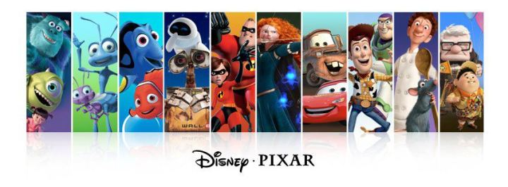
problem
The growth of women comes from the absence of men
Male viewers' anxiety and replacement concept
Comments on the director

Slide 12
Conclusion
From the initial appendage or vase role to highlight the male role, female Roles have become the sole protagonist. Yet still face many problems. In order to solve it, creators should understand more about female psychology and the social context of feminism, so that feminism no longer becomes some kind of political correctness.

Slide 13
Thank you

